Slide 1

WEEK 4
CESAR A. PASCAL

Slide 2
Following the focus of the previous week, I worked on advancing the training process of the Unitree G1 model by using existing walking data instead of training from scratch. I integrated the data into the training pipeline, adjusted the GRU-based policy to better match the G1 configuration, and tested the results in MuJoCo to evaluate walking stability and motion quality.

Slide 3
The training uses behavior cloning to teach a GRU (Gated Recurrent Unit) neural network to imitate the expert walking policy recorded in the dataset. The CSV data is loaded, observation features are normalized, and the time-series data is converted into fixed-length sequences so the GRU can learn temporal dependencies across timesteps. During each epoch, batches of sequences are passed through the network, which predicts joint actions. The predicted actions are compared to the expert actions using mean squared error loss, and gradients are computed through backpropagation. The optimizer updates the network weights over many epochs, allowing the GRU to learn gait timing, coordination, and stabilization through its recurrent memory mechanism.

Slide 4
Why GRU over other RNN?
A Simple Recurrent Neural Network (RNN) suffers from several limitations, including vanishing gradients, exploding gradients, and short-term memory issues that make it difficult to capture long-term dependencies. The Gated Recurrent Unit (GRU) addresses these problems by introducing gating mechanisms that regulate information flow through the network. Compared to the Long Short-Term Memory network (LSTM), the GRU is simpler in architecture, computationally faster, and generally more stable during training.

Slide 5
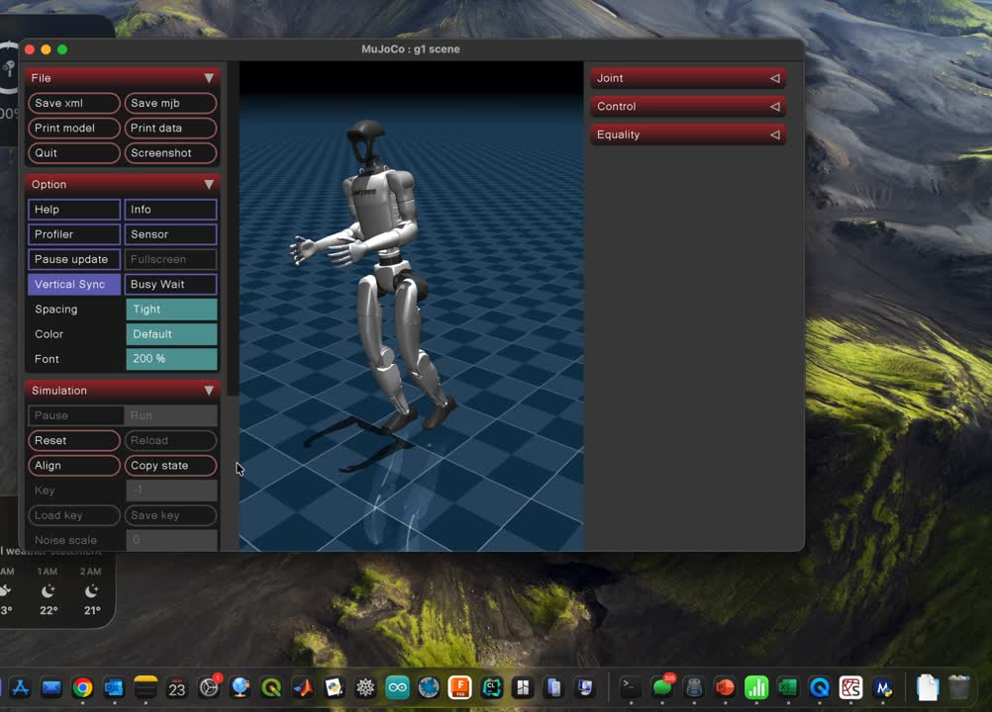

Slide 6
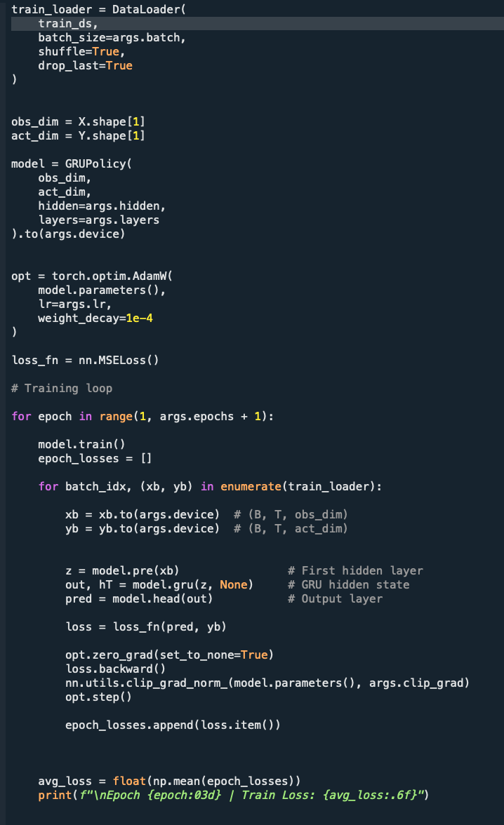

Slide 7
Next steps:
explore upper body mobility (arms and torso) and investigate additional MuJoCo functionalities to expand the model’s control capabilities and simulation features.

Slide 8
References
Cho, K., van Merriënboer, B., Bahdanau, D., & Bengio, Y. (2014). Learning Phrase Representations using RNN Encoder–Decoder for Statistical Machine Translation. arXiv:1406.1078.
Paszke, A., Gross, S., Massa, F., et al. (2019). PyTorch: An Imperative Style, High-Performance Deep Learning Library. Advances in Neural Information Processing Systems (NeurIPS).
Todorov, E., Erez, T., & Tassa, Y. (2012). MuJoCo: A Physics Engine for Model-Based Control. IEEE/RSJ International Conference on Intelligent Robots and Systems (IROS).
OpenAI. (2024). MuJoCo Documentation. https://mujoco.readthedocs.io

